Slide 1
What Are People Saying about Lawyers on Yelp?
Team Bashplotlib
Jared Case Kelly Kayser
Milan Chen Michael Obermire

Slide 2
Questions:
What types of lawyers are Yelped about most?
Where do people Yelp most about lawyers?
How does the rating of a type of lawyer compare to the sentiment of the text of the reviews for that type of lawyer?

Slide 3
Data Sources
Yelp API
Random City Lib [pydbgen]

Slide 4
Data Cleaning
Started at about 30,000 reviews, cleaned to 6,000
Duplicates
Non-US
Businesses with reviews under 1,000

Slide 5
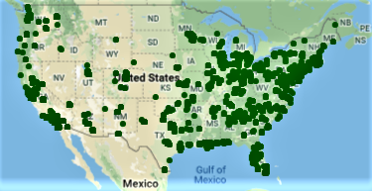
Randomization of cities in the US

Slide 6
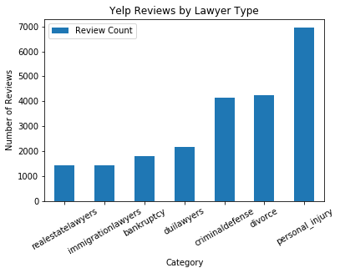
Question 1: What types of lawyers are Yelped about most?

Slide 7
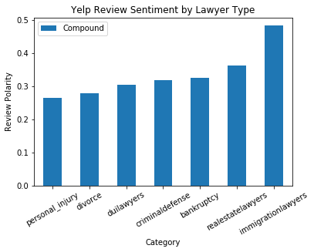
Which type of lawyers have the most positive Yelp reviews?

Slide 8
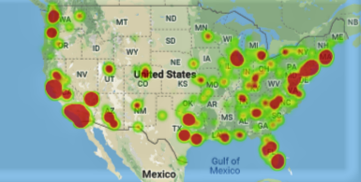
Where do people Yelp most about lawyers?

Slide 9
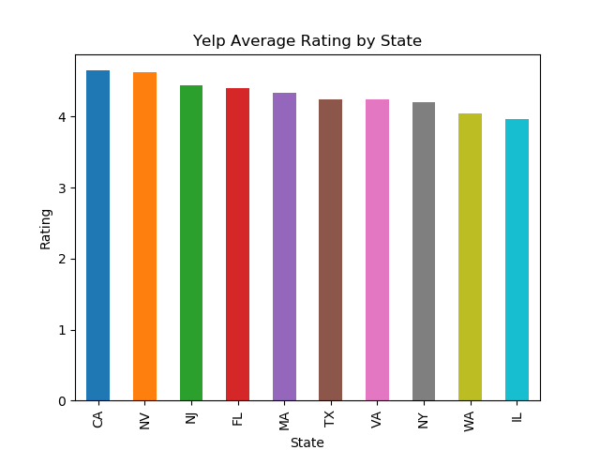

Slide 10
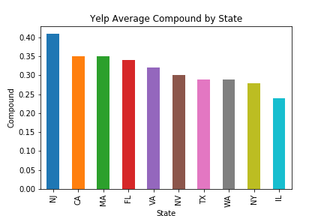

Slide 11
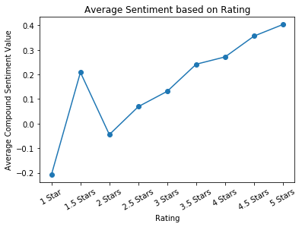
Question 3: How does the rating of a type of lawyer compare to the sentiment of the text of the reviews for that type of lawyer?

Slide 12
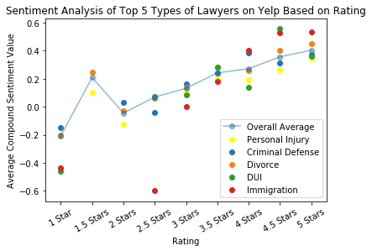

Slide 13
Limitations
Limited API calls (5,000 calls every 24 hour)
3 reviews per company
Not every company has a lawyer classification – defaults to lawyer
Each review only has 166 characters

Slide 14
Conclusions
What types of lawyers are Yelped about most?
Personal Injury, Divorce, and Criminal Defense Lawyers
Where do people Yelp most about lawyers?
Larger metropolitan areas, particularly concentrated on the coasts with a “hot spot” in Chicago
How does the rating of a type of lawyer compare to the sentiment of the text of the reviews for that type of lawyer?
Users are generally leaving reviews that accurately reflect the ratings given

